Slide 1

Note: The data and information in this document is reflective of a hypothetical situation and client. This document is to be used for KPMG Virtual Internship purposes only.
Sprocket Central Pty Ltd
Data analytics approach
Aditya Singh Kashyap

Slide 2
Note: The data and information in this document is reflective of a hypothetical situation and client. This document is to be used for KPMG Virtual Internship purposes only.
Agenda
Introduction
Data Exploration
Model Development
Interpretation

Slide 3
Note: The data and information in this document is reflective of a hypothetical situation and client. This document is to be used for KPMG Virtual Internship purposes only.
Introduction
Data Exploration.
Data Exploration helps in understanding the underlying and fundamental characteristics of the dataset. It can depict whether the data is normally distributed or is skewed towards a certain demographic. For instance, the data could be highly dependent on the age bracket or whether they own a car or not.
Understanding the features and scope data and gather external data which is useful for modelling purposes. For example, the geographic remoteness of different postcodes may be used as an indicator of proximity to consider to whether a customer needs a bike for a ride to work.
Exploring the relationship between the independent variables via correlation analysis and look out for multicollinearity by creating interaction variables. Correlation may occur between explanatory variables age and tenure – people of the older brackets will have a longer tenure.
Furthermore, the raw data could be transformed into an appropriate format for analysis. This may include steps such as ensuring that the data types are valid and rolling data up to an aggregated level. Or, joining in already aggregated ABS data at a geographic level to create additional variables.
Document assumptions, limitations and exclusions for the dataset; as well as how the scope for improvement in the next stage if there was additional time to address assumptions and remove limitations.
Classification could be used to predict sale results/decisions.
Regression would help in predicting the sales – dependent variable – using the set of independent variables.

Slide 4
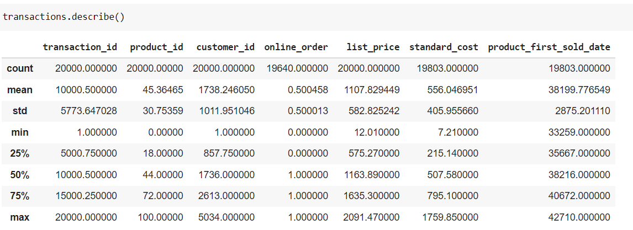
Note: The data and information in this document is reflective of a hypothetical situation and client. This document is to be used for KPMG Virtual Internship purposes only.
Data Exploration
Exploratory Data Analysis.

Slide 5
Note: The data and information in this document is reflective of a hypothetical situation and client. This document is to be used for KPMG Virtual Internship purposes only.
Model Development
Factors pertaining to Model Development.
Firstly, we need to formulate Null and Alternate Hypotheses related to the business question that can be answered with the data, using statistical significance testing to determine if the hypothesis – whether model or variables – is valid or not.
Using existing data to generate calculated field for yielding extra information. For instance, converting the Date of Birth into an age bracket. Other fields that may be engineered include ‘High Margin Product’ – which may indicate whether the product purchased by the customer is a high margin category in the past three months based on the fields ‘list_price’ and ‘standard cost’.
Additionally, we can understand and determine what the predicted variable is. For example, are results predicted in ordinal buckets, nominal, binary or continuous. Test the performance of the model using factors relevant for the given model chosen and Significance tests – namely Residual Deviance, ROC curves, R Squared, ANOVA, F1-Score, Precision, Recall, Classification Accuracy, etc. Appropriately documenting model performance, assumptions and limitations.

Slide 6
Note: The data and information in this document is reflective of a hypothetical situation and client. This document is to be used for KPMG Virtual Internship purposes only.
Interpretation
The interpretation helps in understanding the data as a summary.
Visualisation and presentation of model findings and data information.
Here, interpretation of the significant variables and co-efficient is done which aligns with the business’ problem statement. These visual slides will tell a compelling storing around the pertaining issue and support our case with quantitative and qualitative observations.
We will use Power BI for data presentation and dashboards.

